Slide 1
The History of the Marquise Diamond
By Stewart & Associates R.I.G, LLC
August 2022

Slide 2
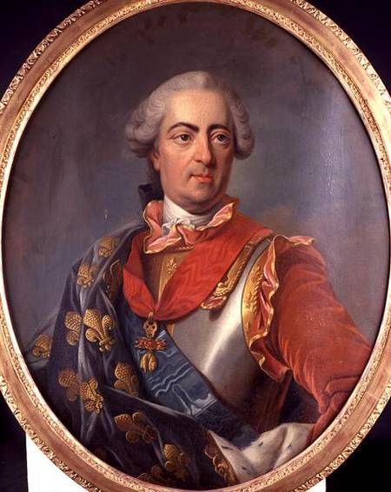
Meet King Louis XV

Slide 3
The King's Bio
Born February 15, 1710 - Died May 10, 1774
Ruled France from September 1, 1715 to death
Lost stakes in America to Great Britain in 1763 (New France)

Slide 4
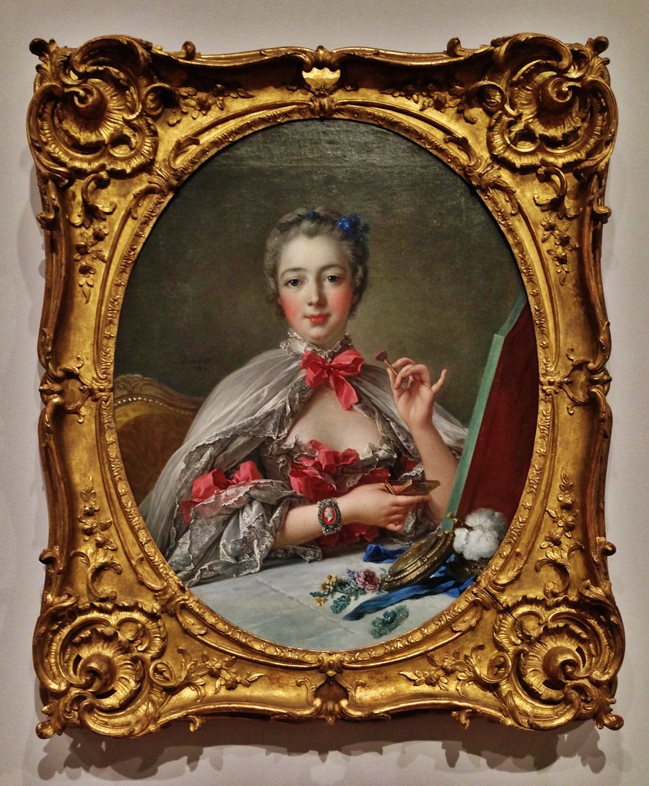
Jeanne Antoinette Poisson, Marquise de Pompadour
Close friend of King Louis XV
King Louis commissioned a jeweler to design a cut shape stone that resembled Marquise de Pompadour lips and named it Marquise diamond
Marquise de Pompadour was the official Chief Mistress of King Louis XV

Slide 5
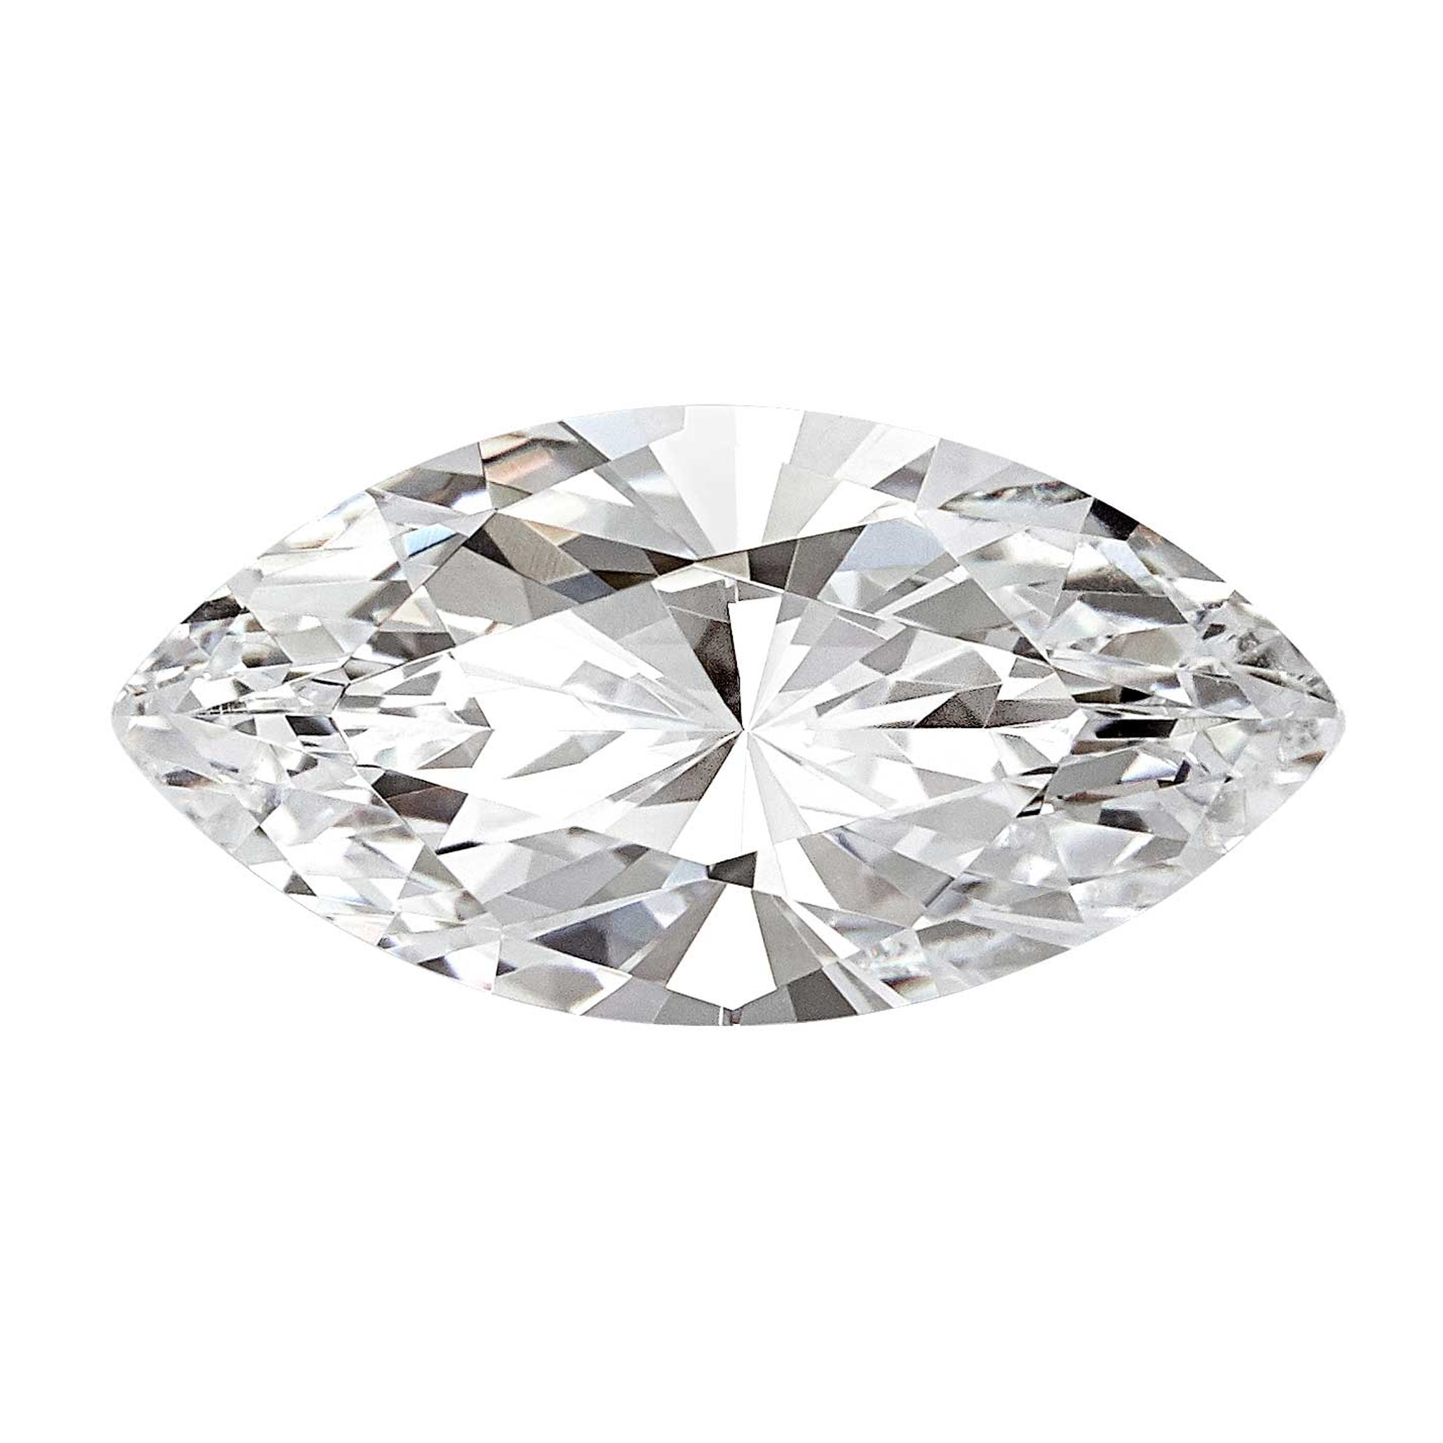
The Marquise Diamond
It is a Diamond Shape
Longer than Wide
Excellent for Engagement Rings

Slide 6

Stewart & Associates R.I.G, LLC
https://www.britannica.com/biography/Louis-XV
https://www.smithsonianmag.com/smart-news/madame-de-pompadour-was-far-more-mistress-180967662/

